Slide 1
1300-1522
Unit 7: The Renaissance, Exploration and Conquest

Slide 2
The Start of the Renaissance
The Renaissance began in Italy, then spread north to the rest of Europe. Italy was the birthplace of the Renaissance for several reasons. The Renaissance was marked by a new interest in the culture of ancient Rome.
Italy differed from the rest of Europe in other ways. Its cities survived the Middle Ages. In the north, city-states like Florence, Milan, Venice, and Genoa grew into prosperous centers of trade and manufacturing. Rome, in central Italy, and Naples, in the south along with a number of smaller city-states, also contributed to the Renaissance cultural revival.

Slide 3
A wealthy and powerful merchant class in these city-states further promoted the cultural rebirth. These merchants exerted both political and economic leadership, and their attitudes and interests helped to shape the Italian Renaissance.
They stressed education and individual achievement. They also spent huge sums of money to support the arts and make their cities more beautiful.
Florence, perhaps more than any other city, came to symbolize the energy and brilliance of the Italian Renaissance. Like the ancient city of Athens, it produced a dazzling number of gifted poets, artists, architects, scholars, and scientists in a short span of time.

Slide 4
In the 1400s, the Medici family of Florence organized a successful banking business. Before long, the family expanded into other industries ranking among the richest merchants in all of Europe. This money translated into cultural and political power. The Medici family became generous patrons, or financial supporters of the arts.
The Renaissance became a time of creativity and change in many areas—political, social, economic, and cultural. Perhaps most important, however were the changes that took place in the way people viewed themselves and their world.

Slide 5
Wealthy families
support arts,
literature, and
education, based
on the classical
cultures of
Greece and Rome.
Flowering
of arts and
learning
Italian city-
states become
wealthy from
trade.
Causes and Effects of the Renaissance

Slide 6
A Golden Age in the Arts
The Renaissance attained its most glorious expression in its paintings, sculpture, and architecture. Wealthy patrons played a major role in this artistic flowering. Popes and princes supported the work of hundreds of artists.
Roman art had been very realistic, and Renaissance painters developed new techniques for representing both humans and landscapes in a realistic way. Renaissance artists learned the rules of perspective. By making distant objects smaller than those close to the viewer, artists could paint scenes that appeared three-dimensional.

Slide 7
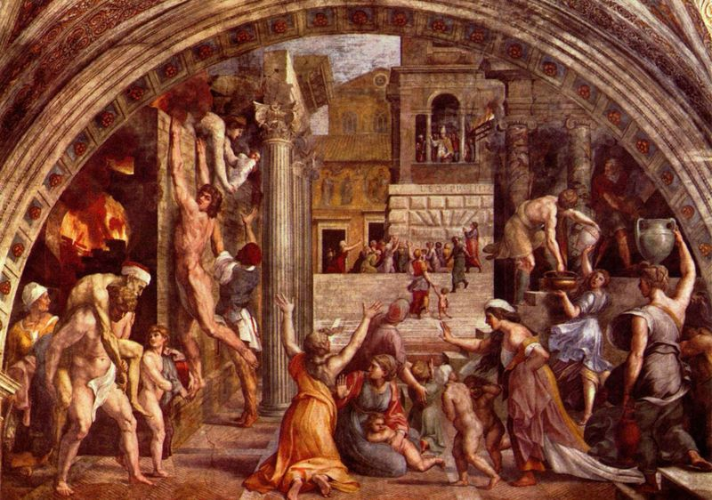
Linear perspective. Figures in foreground appear larger, while background figures appear smaller.

Slide 8
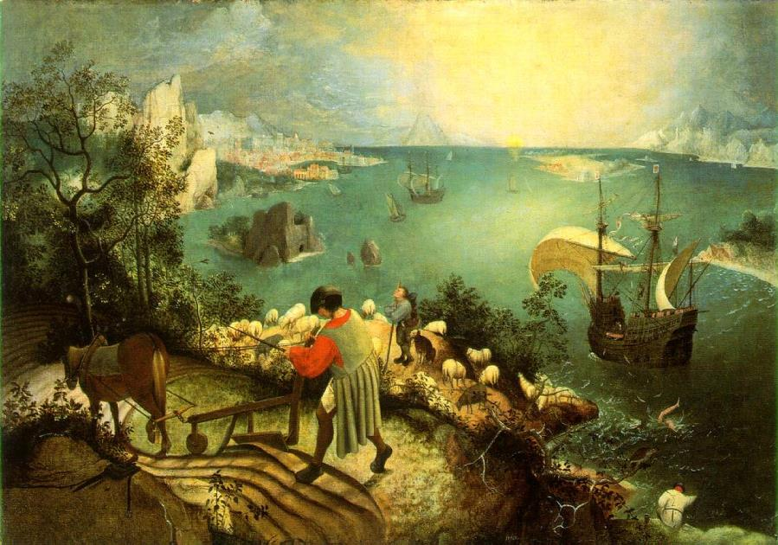
More interest in depicting nature.
Pieter Bruegal the Elder’s
The Fall of Icarus combines several elements of Renaissance art: It reflects the
renewal of interest in Greek
mythology, as well as the interest in representing nature.

Slide 9
Renaissance Florence was home to many outstanding painters and sculptors. The three most celebrated Florentine masters were Leonardo da Vinci, Michelangelo, and Raphael.
Da Vinci was a true Renaissance man, meaning he had many talents. He made sketches of nature and models in his studio. He even dissected corpses to learn how bones and muscles work.

Slide 10
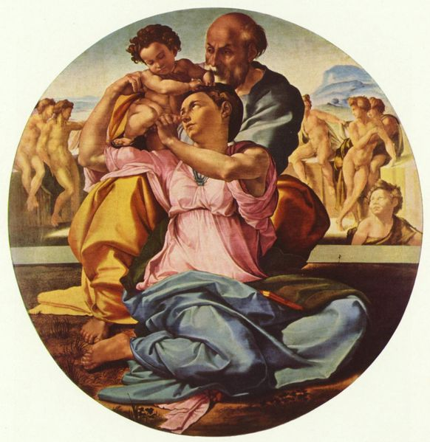
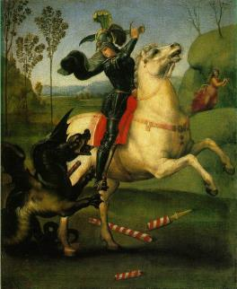
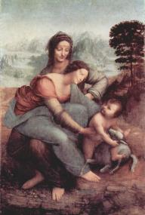
Michelangelo
Renaissance
Raphael
Painting
Leonardo da Vinci
Michelangelo was
a sculptor, painter,
poet, and engineer.
David and Pieta
are two of his most
famous sculptures.
He also painted
the Sistine Chapel.
Rafael is considered
one of the three
great masters of the
Renaissance, along
with Michelangelo
and Leonardo da
Vinci. His paintings
are found at the
Vatican in Rome.
Leonardo da Vinci was
a true “Renaissance
Man.” He excelled in
many areas; he was a
painter, engineer,
botanist, musician,
anatomist, inventor,
architect, and writer.

Slide 11
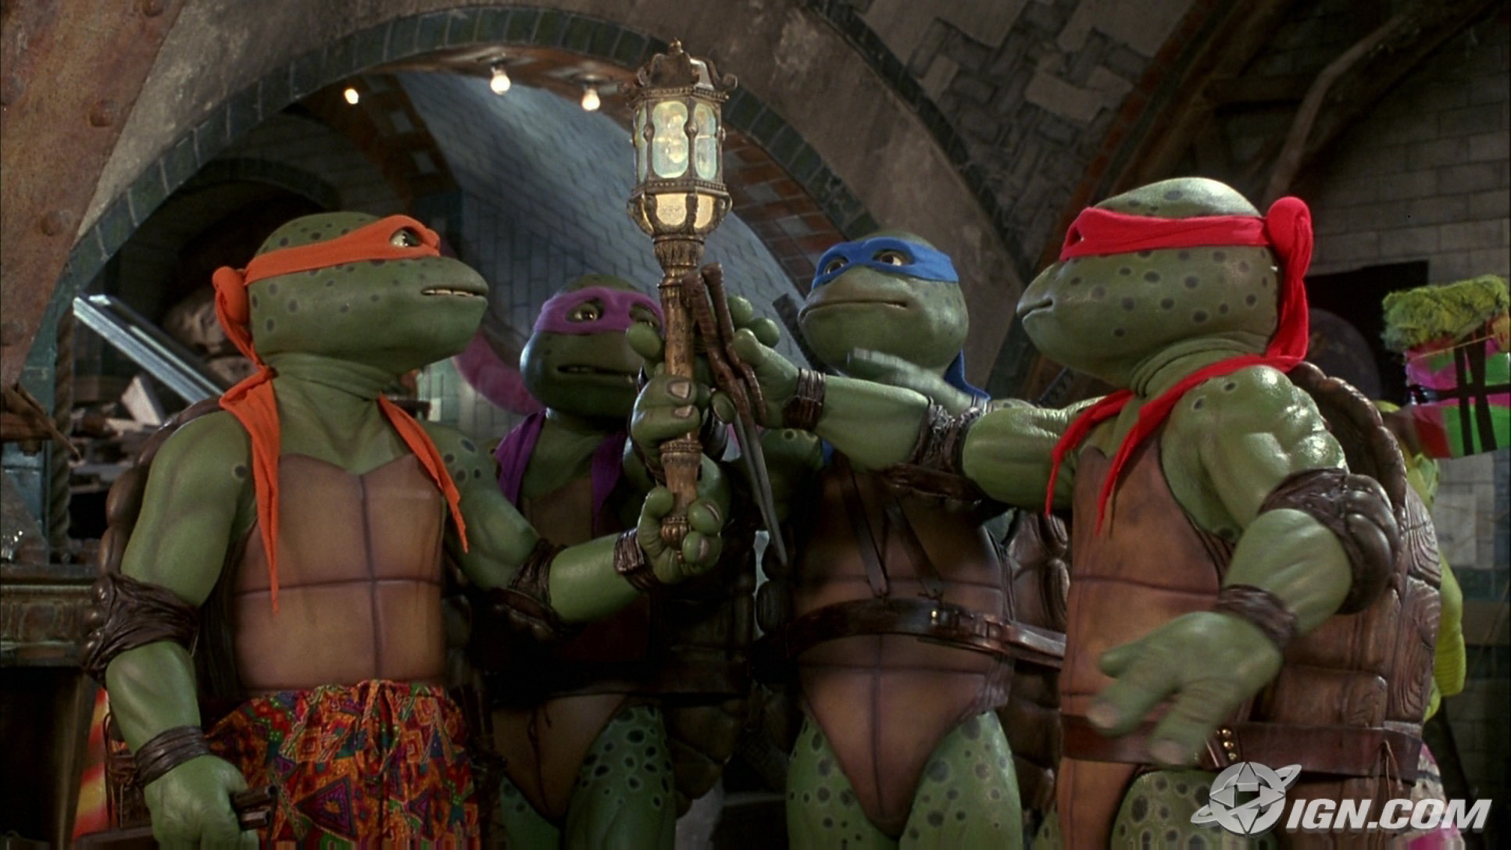
Donatello
Michelangelo
Raphael
Leonardo

Slide 12
Today most people admire Leonardo’s paintings for their freshness and realism. Most popular is the Mona Lisa, a portrait of a woman whose mysterious smile has baffled viewers for centuries.
The Last Supper, showing Christ and his apostles on the night before the crucifixion, is both a moving religious painting and a masterpiece of perspective.
Leonardo thought of himself as an artist, but his talents and accomplishments ranged over many areas. His interests extended to botany, anatomy, optics, music, architecture, and engineering. He made sketches for flying machines and undersea boats centuries before the first airplane or submarine were actually built

Slide 13
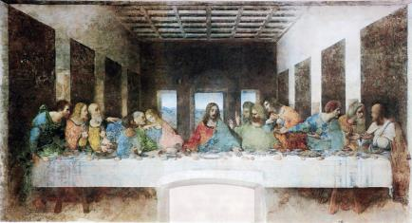
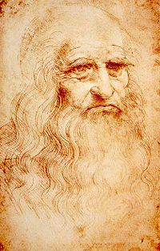
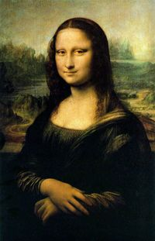
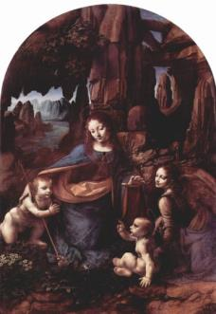
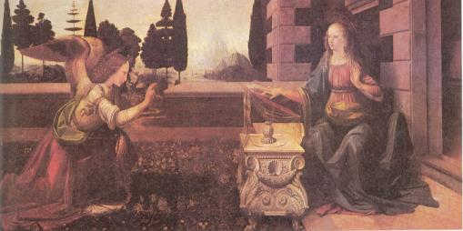
Leonardo da Vinci,
Self-portrait
The Last Supper, 1498
Shakespeare
wrote
Romeo and
Juliet
1594-1595
The Virgin and Child with St. Anne c.1510
The Annunciation
1475-1480
Virgin of the Rocks
1505-1508
Mona Lisa

Slide 14
Like Leonardo, Michelangelo was a many-sided genius—sculptor, engineer, painter, architect, and poet. As a young man, he shaped marble into masterpieces like the Pietá, which captures the sorrow of Mary as she cradles the dead Christ on her knees. Michelangelo's statue of David, the biblical shepherd who killed the giant Goliath, recalls the harmony and grace of ancient Greek tradition.
One of Michelangelo’s greatest projects was painting a huge mural to decorate the ceiling of the Sistine Chapel in Rome. It was an enormous task, depicting the biblical history of the world, from the Creation to the Flood. For four years, the artist laid on his back on a wooden platform suspended just a few inches from the chapel ceiling.

Slide 15
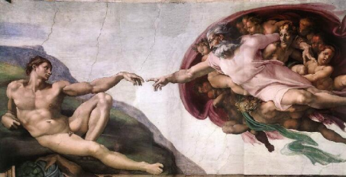
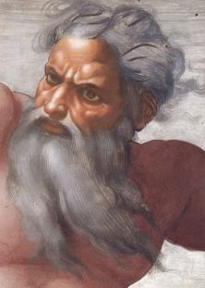
The Creation of Adam
Detail of the face of God from the Cistine Chapel by
Michelangelo
God separating the waters from the heavens.

Slide 16
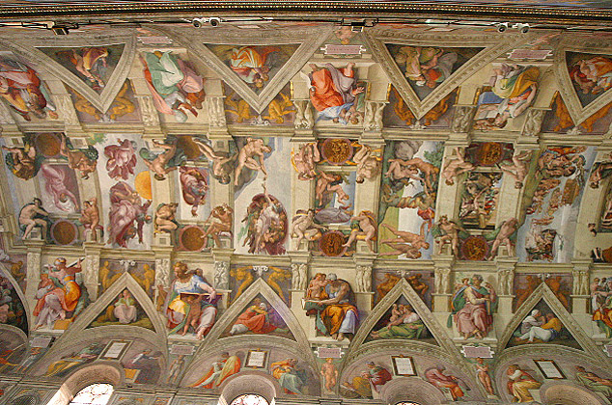
Michelangelo’s ceiling of the Sistine Chapel, Rome.

Slide 17
A few years younger than Leonardo and Michelangelo, Raphael studied the works of those great masters. His paintings blend Christian and classical styles. He is probably best known for his tender portrayals of the Madonna, the mother of Jesus.
In The School of Athens, Raphael pictures an imaginary gathering of great thinkers and scientists, such as Plato, Aristotle, Socrates, and the Arab philosopher Averroes. With typical Renaissance self-confidence, Raphael included the faces of Michelangelo, Leonardo—and himself.

Slide 18
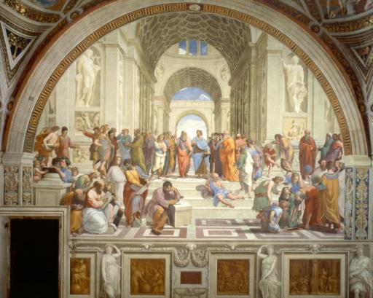
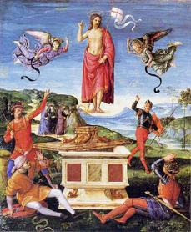
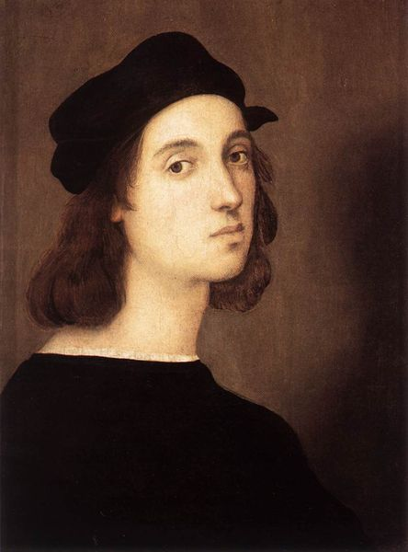
School of Athens
left: Resurrection of
Christ
St. George
Self-portrait
by Raphael

Slide 19
Renaissance Writers
One of Florence’s most famous writers was Niccolò Machiavelli. In The Prince, Machiavelli stressed that the end justifies the means. He urged rulers to use whatever methods were necessary to achieve their goals. On the issue of honesty in government, for example, he taught that getting results was more important than keeping promises.
Machiavelli saw himself as an enemy of oppression and corruption. But critics attacked his cynical advice. Some even claimed that he was inspired by the devil. In fact, the term “Machiavellian” came to refer to the use of deceit in politics.

Slide 20
The towering figure of Renaissance literature was the English poet and playwright William Shakespeare between 1590 and 1613, he wrote 37 plays that are still performed around the world.
Shakespeare’s comedies, such as Twelfth Night, laugh at the follies of young people in love. His history plays, such as Richard III, depict the power struggles of English kings. His tragedies show people crushed by powerful forces of their own weakness. In Romeo and Juliet, two teenagers fall victim to an old family feud.

Slide 21
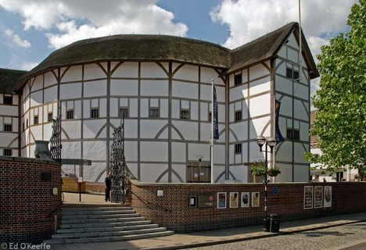
Many of Shakespeare’s plays were performed at the Globe Theater in London

Slide 22
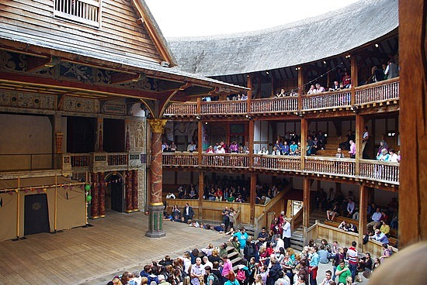

Slide 23
The Protestant Reformation
Beginning in the late Middle Ages, the Church had become increasingly caught up in worldly affairs. Popes competed with Italian princes for political power. Like other Renaissance rulers, popes maintained a lavish lifestyle. Popes were also patrons of the arts. They hired painters and sculptors to beautify churches.
To finance such projects, the Church increased fees for services such as marriages and baptisms. Some clergy also promoted the sale of indulgences. According to Church teaching, an indulgence was forgiveness of sins in exchange for money. This angered many people.

Slide 24
In 1517, protests against Church abuses erupted into a full-scale revolt. The man who triggered the revolt was a German monk and professor of theology named Martin Luther.
In 1517, a priest named Johann Tetzel set up a pulpit on the outskirts of Wittenberg (present day Germany). He offered indulgences to any Christian who contributed money for the rebuilding of the Cathedral of St. Peter in Rome. Tetzel claimed that purchase of these indulgences would assure entry into heaven not only for the purchasers but for their dead relatives as well.

Slide 25
To Luther, Tetzel’s actions were the final outrage. He drew up 95 theses, or arguments, against indulgences. Among other things, he argued that indulgences had no basis in the Bible, that the pope had no authority to release souls from purgatory, and that Christians could be saved only through faith. Luther nailed his 95 theses to Wittenberg’s All Saints Church.
Luther was excommunicated for his beliefs, but he gained many followers. Many followed his lead and left the Catholic church. Luther’s followers were called Lutherans, or Protestants, for those who “protested” church authority.

Slide 26
The English Reformation
At first, English King Henry VIII was against the Protestant Reformation. He denounced Luther and awarded the Pope the title “Defender of the Faith.” However, in 1527, an issue arose that set Henry at odds with the Church.
After 18 years of marriage, Henry and his Spanish wife, Catherine of Aragon, had one surviving child, Mary Tudor. Henry felt that England’s stability depended on him having a male heir. He wanted to marry Anne Boleyn, hoping that she would bear him a son.

Slide 27
Because Catholic law does not permit divorce, he asked the pope to annul, or cancel, his marriage. Popes had annulled royal marriages before. But the current pope refused. He did not want to offend the Holy Roman Emperor Charles V, Catherine’s nephew.
Henry was furious. Spurred on by his advisers, many of whom leaned toward Protestant teachings, he decided to take over the English church. Control of the English church was taken from the pope and placed it under Henry’s rule.
Henry then wed Anne Boleyn, who bore him a second daughter, Elizabeth. Anne Boleyn was later executed for adultery and treason. In the years ahead, Henry married four more times but had only one son, Edward.

Slide 28
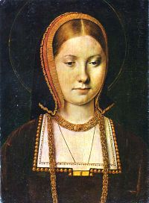
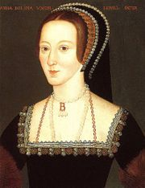
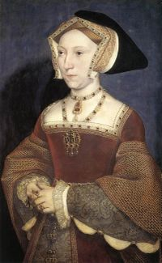
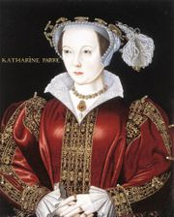
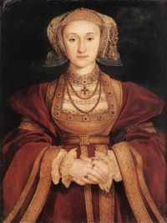
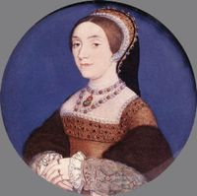
Henry’s Wives

Slide 29
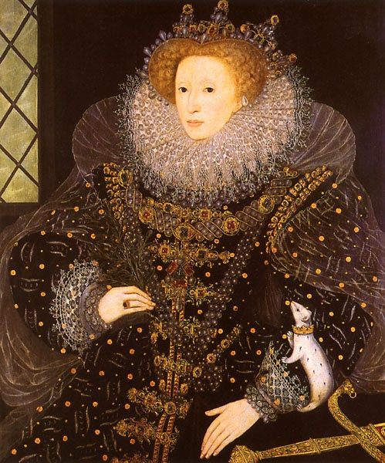
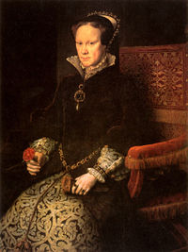
Edward VI
Elizabeth I
Mary I

Slide 30
Widespread Persecution
During this period of heightened religious passion, persecution was widespread. Both Catholics and Protestants fostered intolerance. Catholic mobs attacked and killed Protestants. Protestants killed Catholic priests and wrecked Catholic churches.
Almost certainly, the religious fervor of the times contributed to a wave of witch hunting. Those accused of being witches, or agents of the devil, usually were women, although some men faced similar attacks. Between 1450 and 1750, tens of thousands of women and men died as victims of witch hunts.

Slide 31
Scholars have offered various reasons for this persecution. At the time, most people believed in magic and spirits. They saw a close link between magic and heresy. In addition, during times of trouble, people often look for scapegoats on whom they can blame all their problems. People accused of witchcraft were often social outcasts—beggars, poor widows, midwives blamed for infant deaths, or herbalists whose positions were seen as gifts from the devil.
Most victims of the witch hunts died in the German states, Switzerland, and France, all centers of religious conflict. When the wars of religion came to an end the persecution of witches also declined.

Slide 32
Changing Views of the Universe
Until the mid-1500s, European scholars accepted the theory of the ancient Greek astronomer Ptolemy. Ptolemy taught that the Earth was the center of the universe. Not only did this view seem to agree with common sense, it also matched the teachings of the Church. In the 1500s and 1600s, some startling discoveries radically changed the way Europeans viewed the physical world.
In 1543, Polish scholar Nicolaus Copernicus published On the Revolutions of the Heavenly Spheres. In it, he proposed a heliocentric, or sun-centered, model of the universe. The sun, he said stood at the center of the universe and the Earth was just one of several planets that revolved around it.

Slide 33
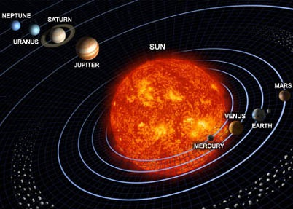

Slide 34
Tycho Brahe and his assistant Johannes Kepler supported Copernicus’ findings. They used data to calculate the orbits of the planets revolving around the sun. In Italy, Galileo Galilei assembled an astronomical telescope. He observed the four moons of Jupiter moving slowly around that planet—exactly, he realized, the way Copernicus said that the Earth moved around the sun.

Slide 35
Galileo’s discoveries caused an uproar. Other scholars attacked him because his observations contradicted ancient views about the world. The Church condemned him because his ideas challenged the Christian teaching that the heavens were fixed, unmoving, and perfect.
In 1633, Galileo was tried and threatened with death unless he withdrew his “heresies,” Galileo agreed to state publicly that the Earth stood motionless at the center of the universe to avoid execution.

Slide 36
A New Scientific Method
Despite the opposition of religious authorities, by the early 1600s a new approach to science had emerged. Unlike most earlier approaches, it did not rely on authorities like Aristotle or Ptolemy or even the Bible. It depended instead upon observation and experimentation.
The new approach to science required scientists to collect and accurately measure data. To explain the data, scientists used reasoning to propose a logical hypothesis, or possible explanation. They tested the hypothesis with further observation or experimentation.

Slide 37
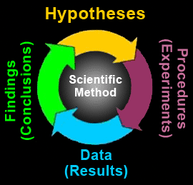

Slide 38
Complex mathematical calculations were used to convert the observations and experiments into scientific laws. After reaching a conclusion, scientists repeated their work at least once—and usually many times—to confirm their findings. This step-by-step process of discovery became known as the scientific method.

Slide 39
Newton
As a student in England, Isaac Newton devoured the works of the leading scientists of his day. By age 24, he had formed a brilliant theory to explain why the planets moved as they did. According to one story, Newton saw an apple fall from a tree. He wondered whether the force that pulled that apple to the Earth might not also control the movements of the planets.

Slide 40
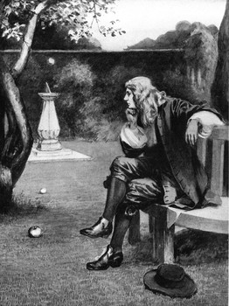
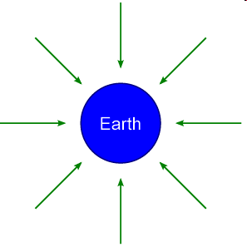
Newton’s discovery of the universal law of gravitation was said to have been inspired by an apple falling from an apple tree.

Slide 41
In the next 20 years, Newton perfected his theory. Using mathematics, he showed that a single force keeps the planets in their orbits around the sun. He called this force gravity. In 1687, Newton published Mathematical Principles of Natural Philosophy, explaining the law of gravity and other workings of the universe. Newton argued that all motion in the universe can be measured and described mathematically.

Slide 42
Exploration
There were only a few large cities in Western Europe before A.D. 1450—only Paris, London, and Naples had 100,000 residents. More than 90 percent of the European population consisted of peasants living in small rural communities. Peasant families usually owned or leased a small dwelling in the village center and had the right to farm strips of land in the surrounding fields.

Slide 44
By the 1400s Europeans desired a cheaper, faster trade route to the East that did not involve traveling through the Mediterranean Sea. They were looking for the Northwest Passage, a way to get to Asia faster.
The Northwest Passage was the name of a sea route across or around North America from the Atlantic Ocean to the Pacific Ocean. From the moment that the existence of a New World was confirmed, European explorers hoped to discover such a route, seeking a short passage to the East Indies and the Orient.

Slide 45
Christopher Columbus
Navigator of the first recorded European expedition to cross the Atlantic in search of the elusive route to Asia, Christopher Columbus landed instead on islands in the Caribbean Sea. His voyage, which was well publicized in Europe, stimulated exploration of what was for 15th-century Europeans an undiscovered world, the Americas.
Although Columbus' discovery of the Americas presented undreamed of opportunities for Europeans, it also marked the beginning of several centuries of famine, disease, dislocation, and violence for the Native American peoples already living in the western hemisphere.

Slide 47
Columbus was a devout Catholic and a struggling Genoese sea captain who was determined to become rich and convert the peoples of Asia to Christianity, misinterpreting the findings of Italian Geographers, Columbus believed that the Atlantic Ocean was a little more than a narrow channel of water separating Europe from Asia.

Slide 48
Columbus theorized that the world was predominately covered in land and that the distance to Asia was much shorter than previously thought. Columbus believed Asia was 3000 miles away (it was actually 13,000 miles). Although Columbus clearly sought adventure, his primary motivations were most likely the pursuit of honor and wealth.
When the King of Portugal rejected Columbus' proposal to finance the voyage, he returned to Spain where he received high praise and royal patronage for his proposed adventure.

Slide 49
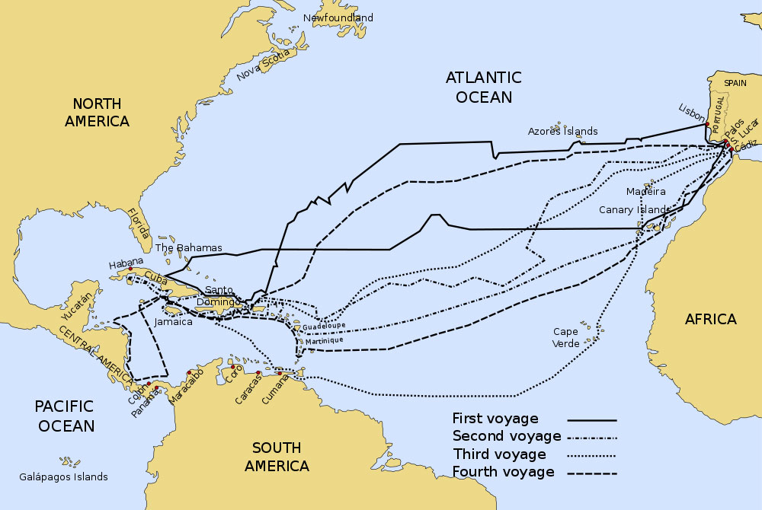

Slide 50
In April 1492, King Ferdinand V and Queen Isabella I of Spain agreed to sponsor the expedition. On the first voyage, Columbus commanded three ships: the Nina, the Pinta, and the Santa Maria. The fleet departed on August 3, 1492 from Palos, Spain.
The length of the voyage tested the will of the new explorers, but on October 12 the expedition sighted Guanahaní, an island in the Bahamas. Columbus renamed the island San Salvador (which translates to“Holy Savior) and claimed it for Spain.

Slide 51
Columbus Presenting His Idea

Slide 52
The first people Columbus encountered were farmers and fisherman. These people called themselves Taino (Ty-noh) the word for “good” or “noble”
The Spanish praised the Taino’s generosity, and greedily observed the gold ornaments that they wore. Columbus believed it would be easy to convert the Taino to Catholicism. Columbus took the Taino’s generosity to mean that they could all be conquered and compelled to do anything one wishes.

Slide 53
Landing on San Salvador

Slide 54
Believing he had reached Asia— “the Indies,” Columbus called the native inhabitants Indians and the islands the West Indies. Although surprised by the rude living conditions of the natives, Columbus expected them to “easily be made Christians, for it appeared to me that they had no religion.”
He then explored the neighboring Caribbean islands, demanding gold from the local Taino, Arawak, and the Carib peoples. He then returned triumphantly to Spain, taking several Tainos to display to Isabella and Ferdinand.

Slide 55
Other Explorers
Some explorers traveled to the lands of North America and South America, claiming them for Spain. In 1513 Vasco Nunez de Balboa explored the area now known as Panama. Balboa crossed Panama and came upon a great body of water, which he called the South Sea. Balboa was probably the first European to glimpse this body of water –later named the Pacific, or “peaceful” Ocean from the Americas.

Slide 56
Balboa

Slide 57
Ferdinand Magellan was a Portuguese mariner who believed that by sailing west he could find a water passageway around the Americas. In 1519 he sailed with five ships under his command and eventually found the passageway he sought at the southern tip of South America.
Although he succeeded in finding a route to Asia he died before he could return to Spain. He lost his life battling native Indians on the Philippine Islands. In September 1522 the Victoria—the only ship remaining of Magellan’s five vessel fleet– sailed into the harbor near Cadiz Spain. Only 35 men survived the voyage of the original 250 that set sail. On this expedition Magellan’s crew became the first people to successfully circumnavigate or sail completely around the world.

